Slide 1



Predicting Solar Power Output Using Linear Regression
Mantra Viralkumar Patel

Slide 2

Learning Objectives
Understand linear regression for predictive modeling.
2. Learn data cleaning and preprocessing techniques.
3. Perform data analysis to identify trends.
4. Implement a machine learning model using Scikit-Learn.
5. Evaluate model performance using MSE and R².
6. Visualize data patterns and results.
7. Explore applications for optimizing solar power systems.
GOAL
Source :
www.freepik.com/

Slide 3
Tools and Technology used
• IDE & Version Control: VS Code, GitHub
• Programming Language: Python 3.12.4
• Libraries: Pandas, Numpy, Seaborn, Scikit-Learn, Pylance
• Data Analysis & Visualization: MS Excel, Jupyter Notebook

Slide 4
Methodology
1. Data Collection: Loaded a dataset containing solar power generation data and influencing factors.
2. Data Preprocessing: Cleaned data, handled missing values, and normalized features for better model performance.
3. Exploratory Data Analysis (EDA): Analyzed data trends and relationships using visualizations.
4. Model Implementation: Built and trained a linear regression model using Scikit-Learn.
5. Model Evaluation: Assessed model accuracy using Mean Squared Error (MSE) and R² score.
6. Result Visualization: Plotted predictions and performance metrics for analysis.

Slide 5
Problem Statement:
Predicting solar power output accurately is crucial for optimizing energy generation, grid management, and resource allocation. Environmental and operational factors such as temperature, sunlight intensity, and time of day influence power output, making it challenging to forecast efficiently. This project aims to develop a predictive model to address this challenge.

Slide 6
Solution:
1. Data Loading and Preparation: Imported and cleaned solar power generation data, handling missing values and normalizing features.
2. Feature Selection: Selected key environmental factors such as temperature, sunlight intensity, and time of day for modeling.
3. Model Development: Implemented a linear regression model using Scikit-Learn to establish relationships between variables and predict power output.
4. Training and Testing: Split the dataset into training and testing sets to build and validate the model.
5. Performance Evaluation: Assessed model accuracy using metrics like Mean Squared Error (MSE) and R² score to ensure reliable predictions.
6. Visualization: Plotted actual vs predicted values and data trends for analysis and performance insights.
7. Scalable Solution: Model design allows adaptation for larger datasets and integration into solar energy management systems.

Slide 7
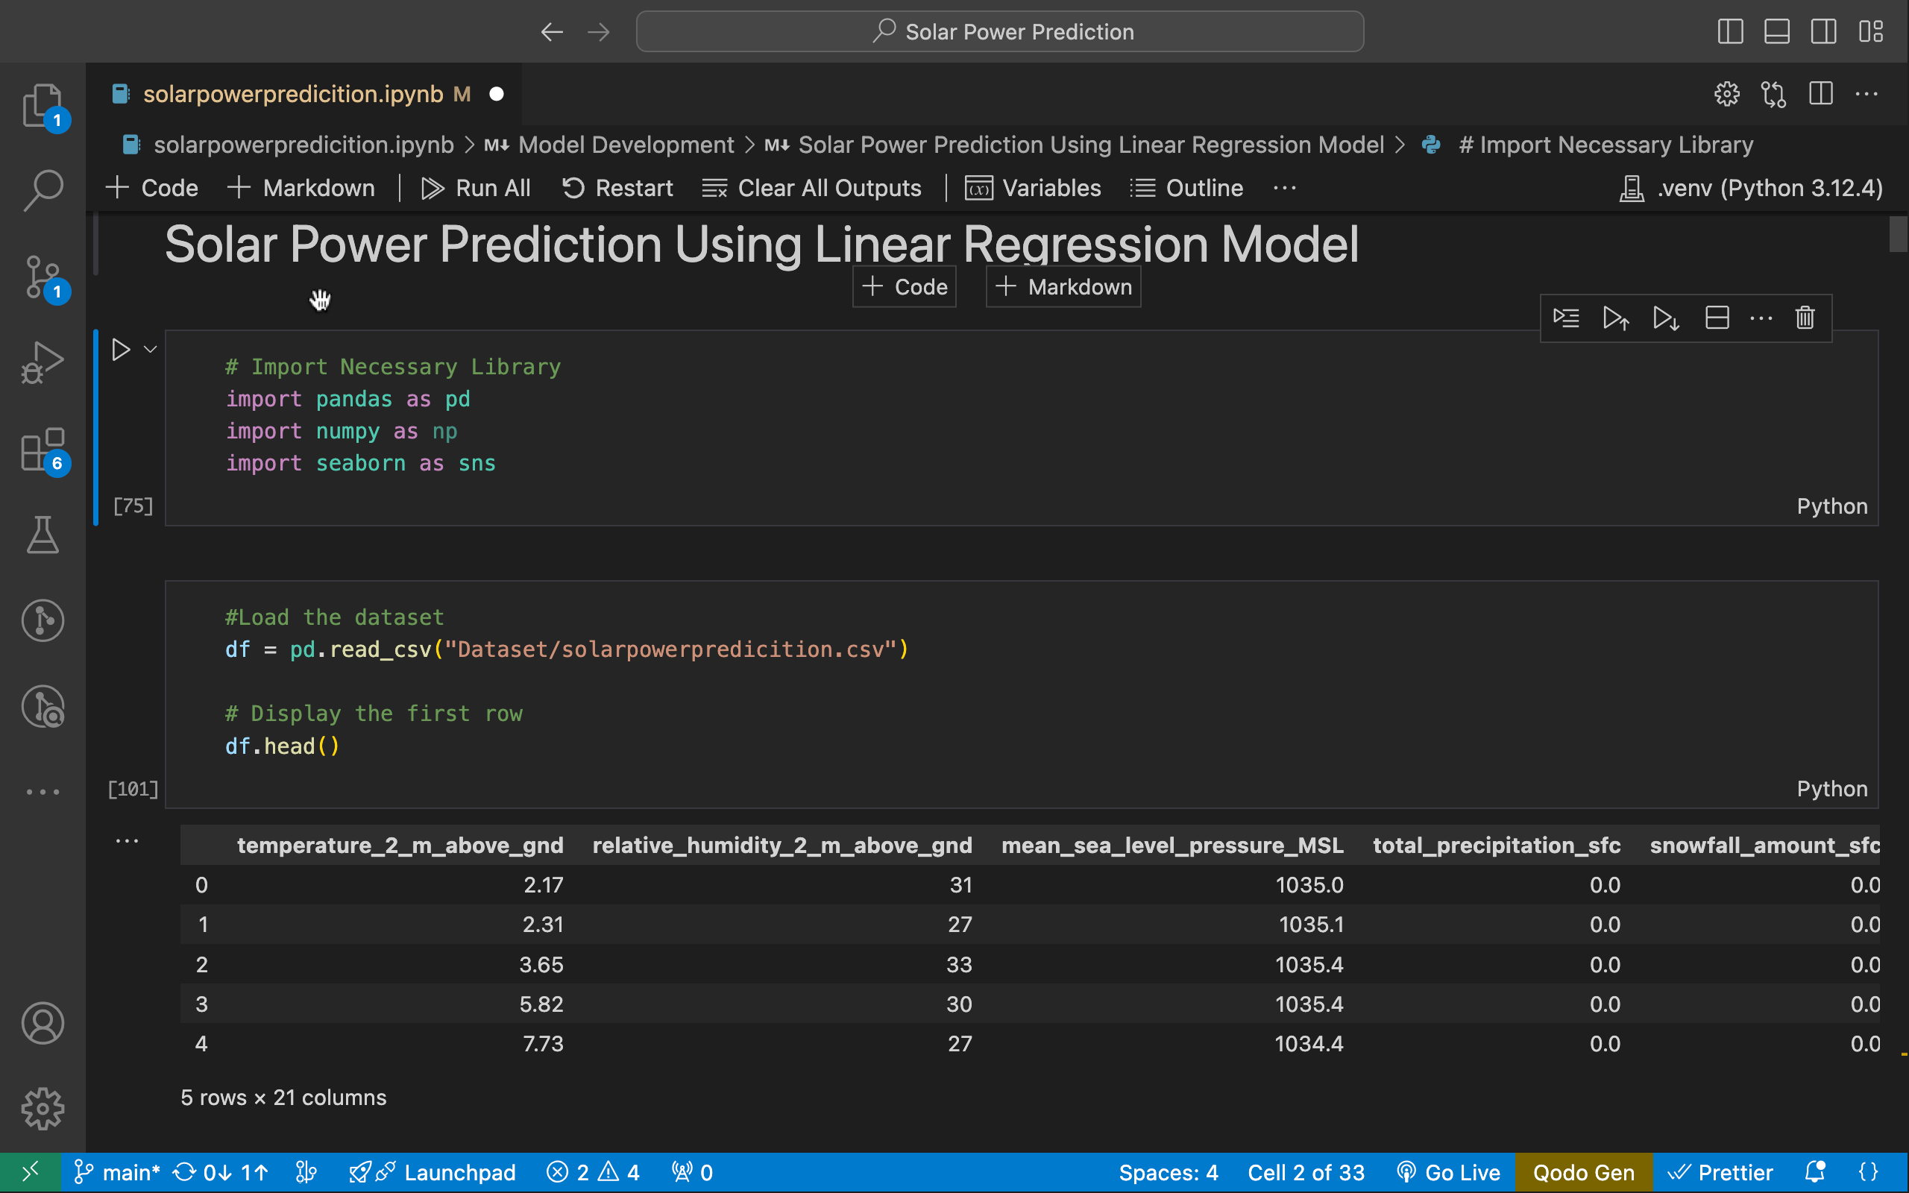
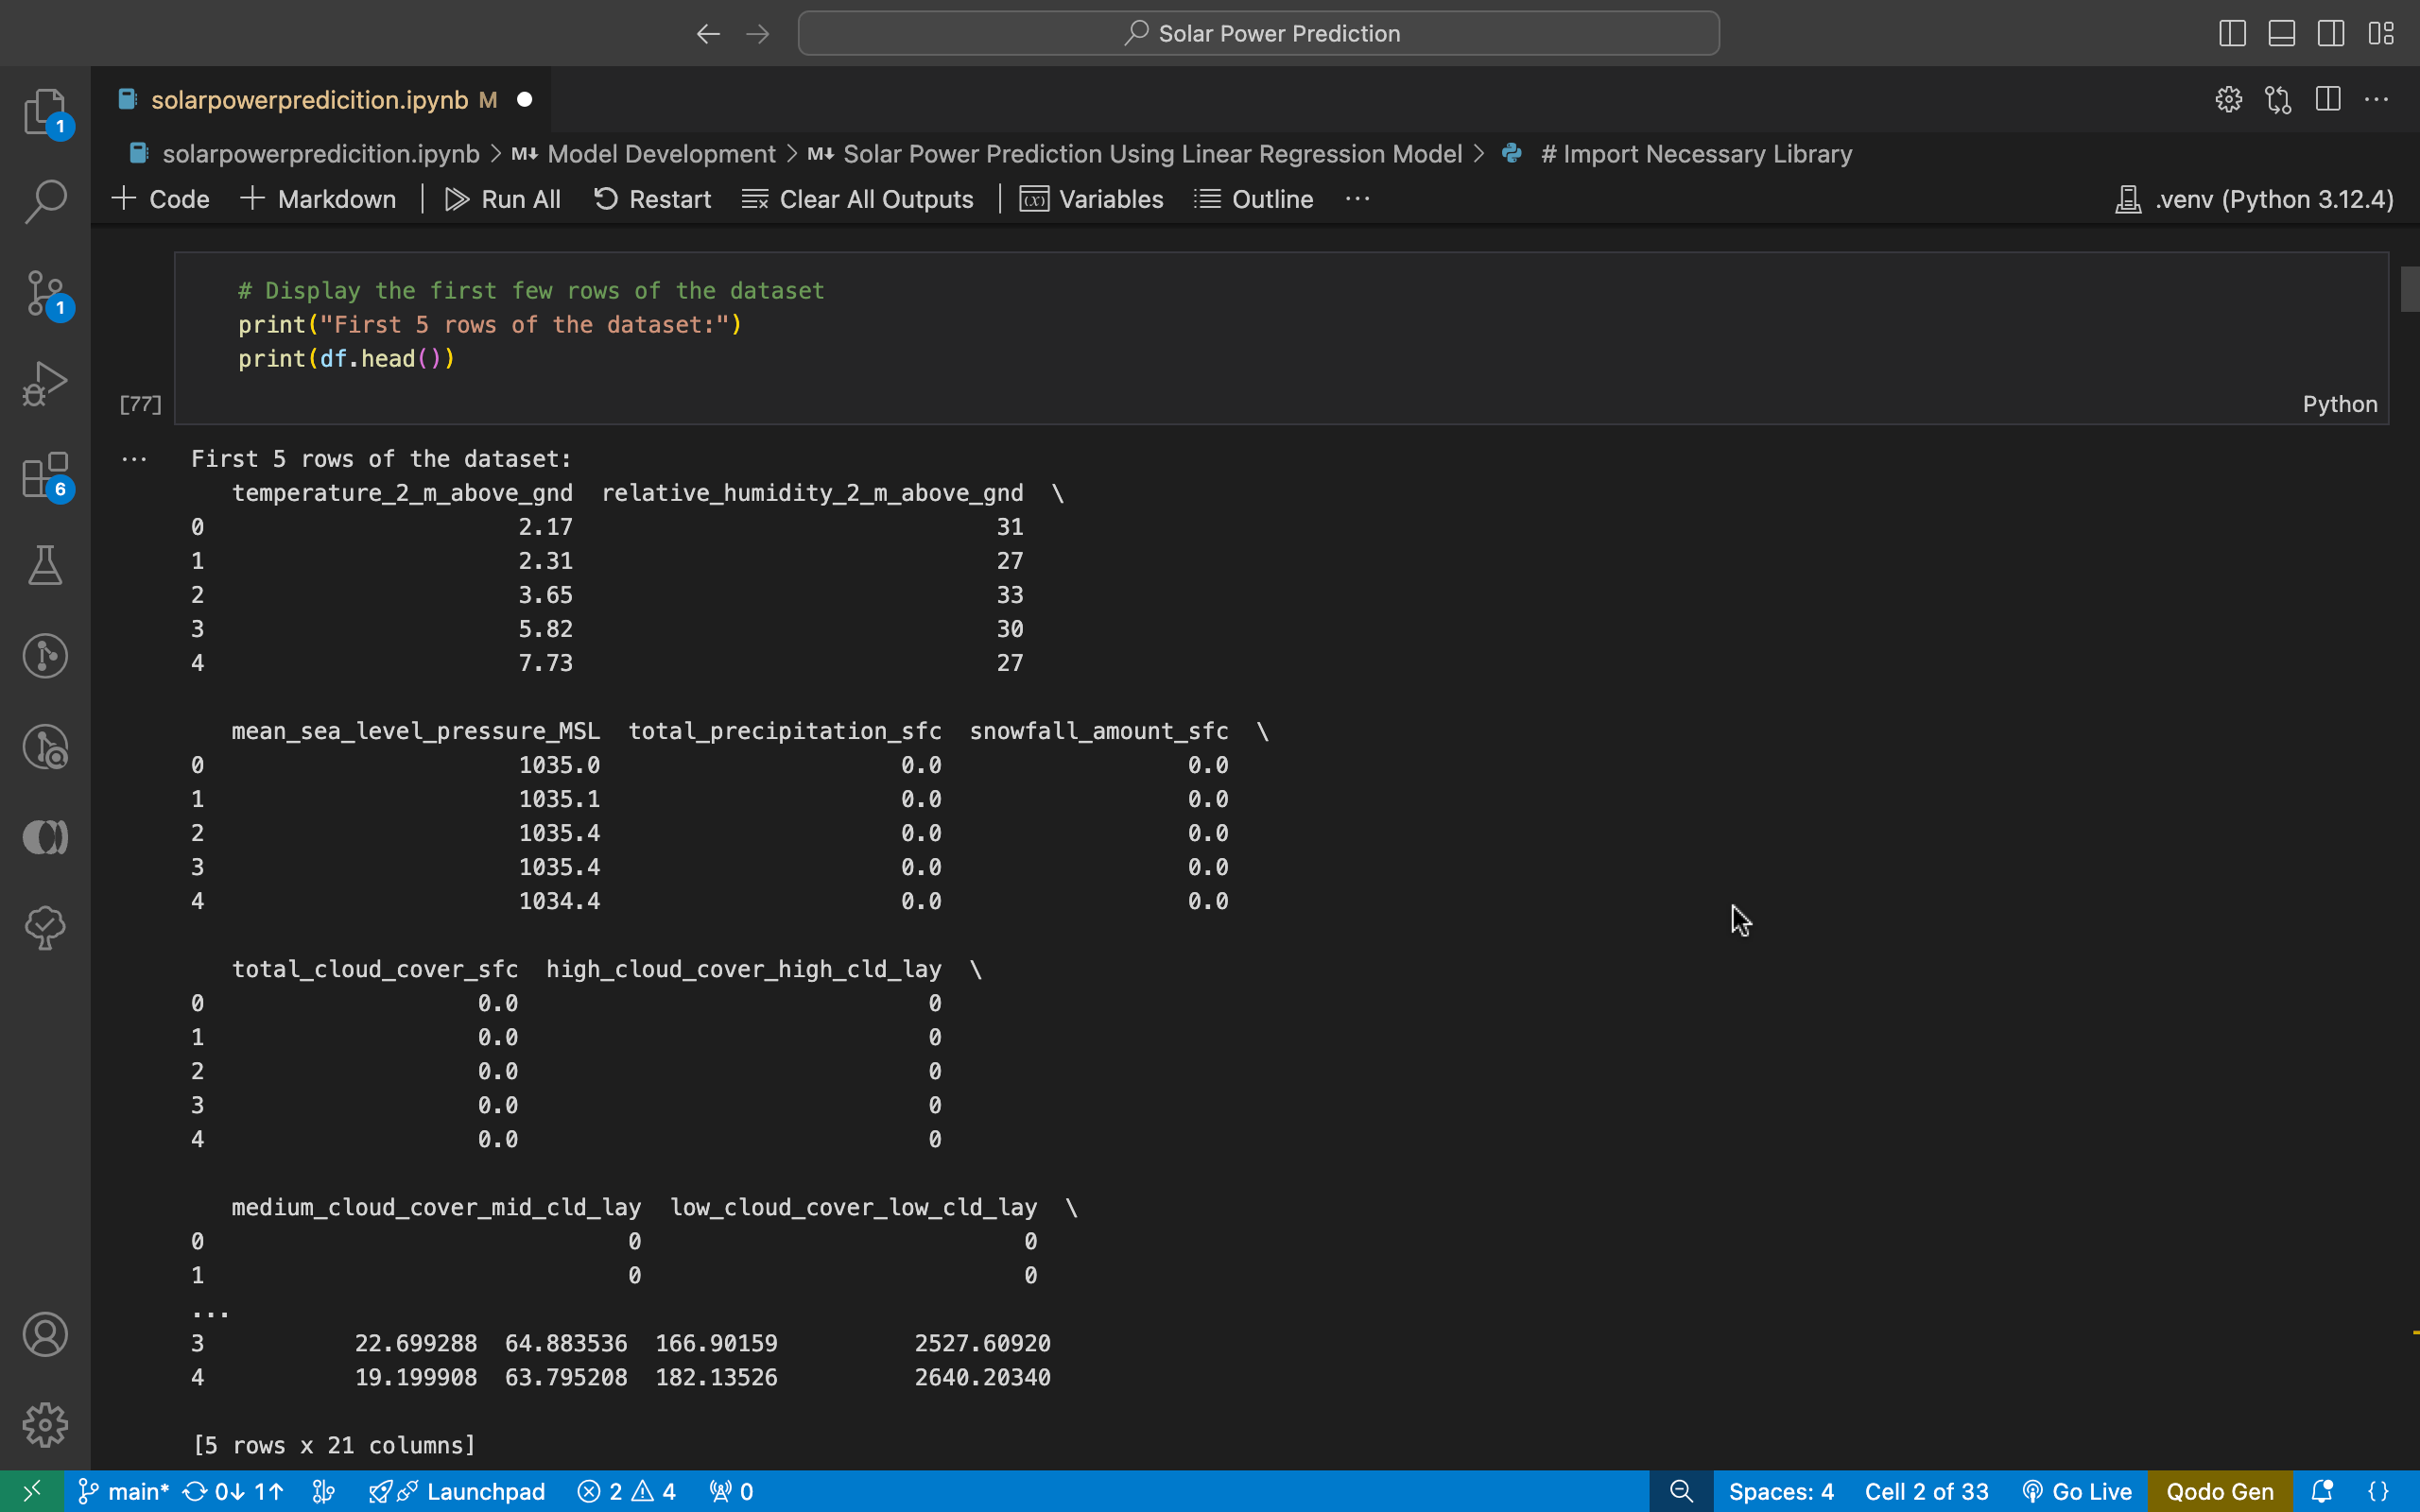
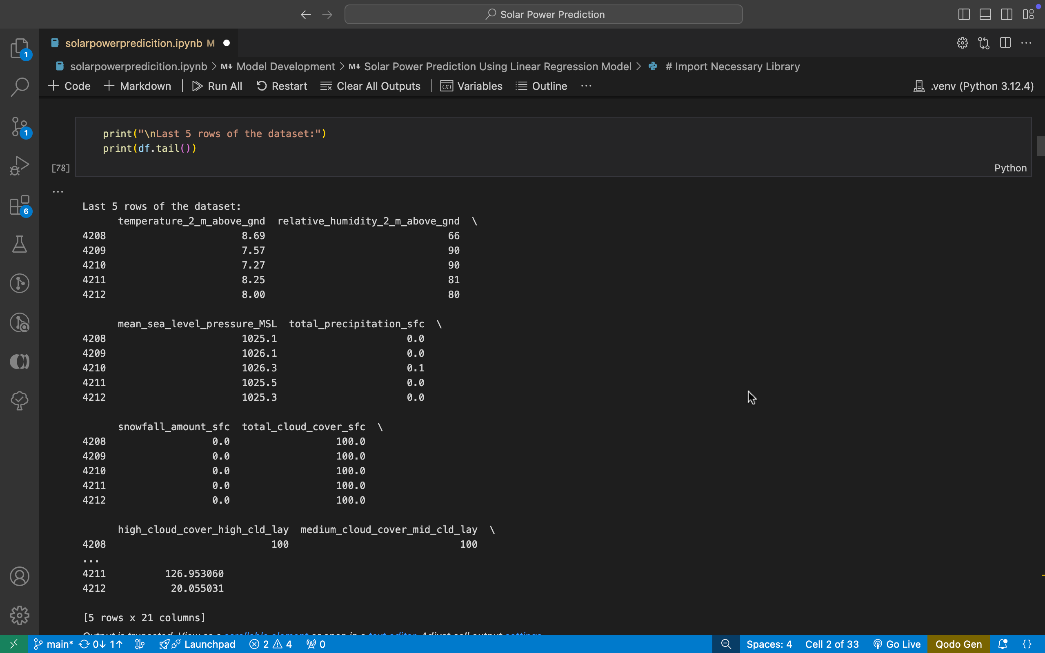
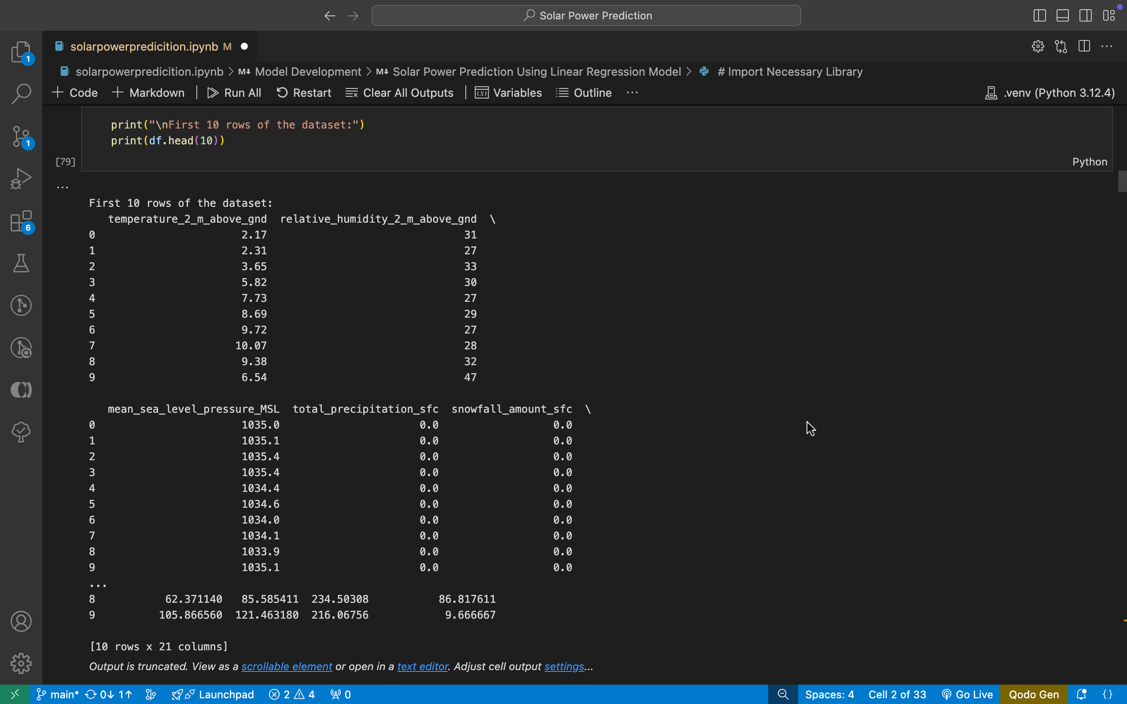
Screenshot of Output:

Slide 8
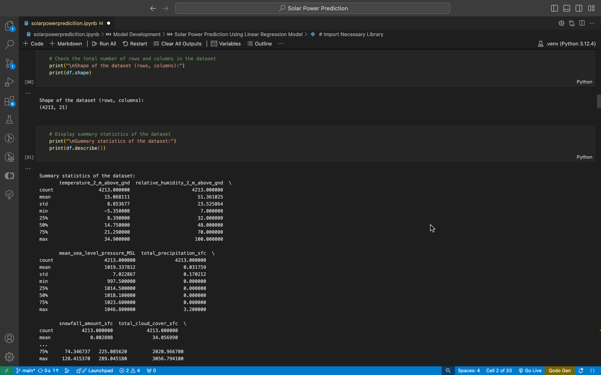
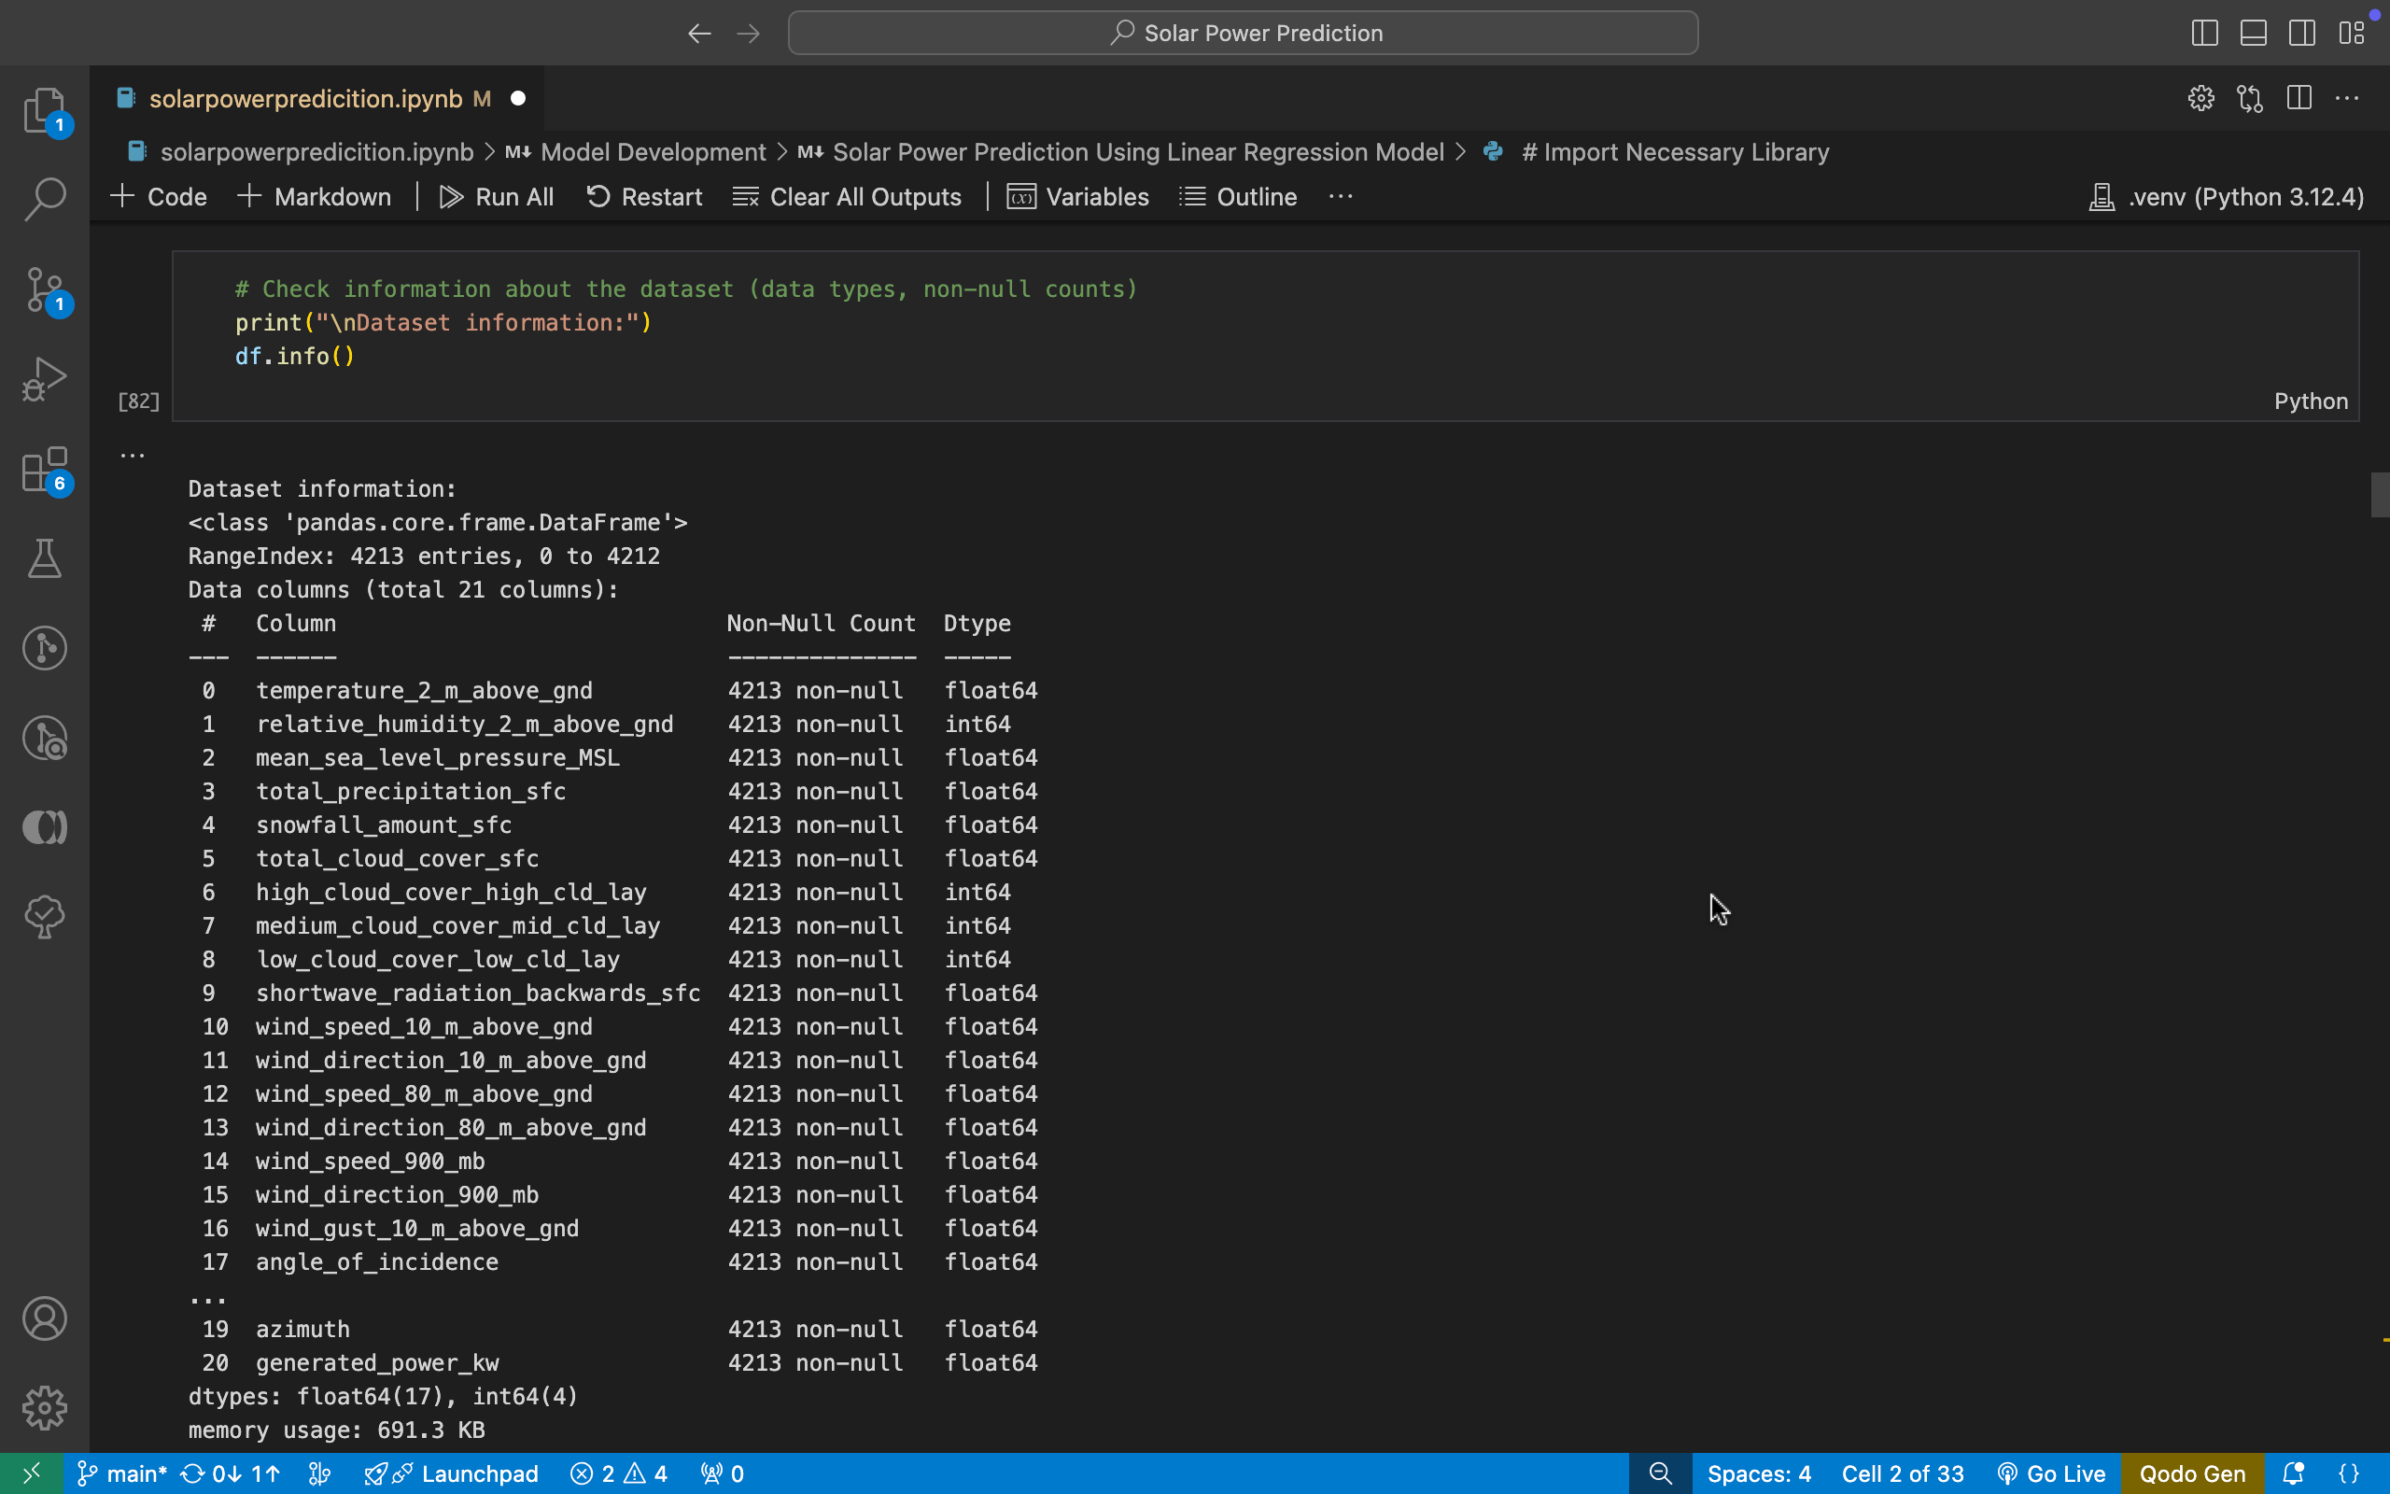
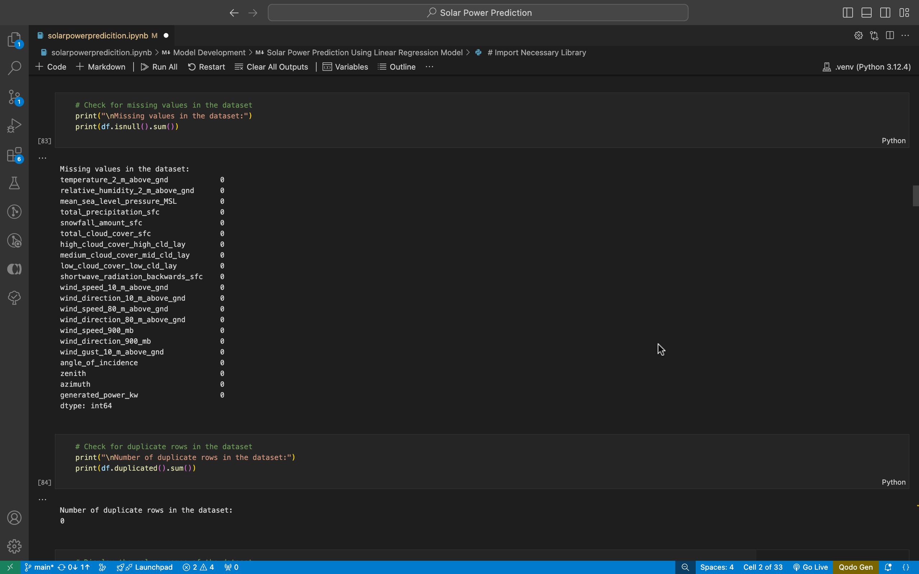
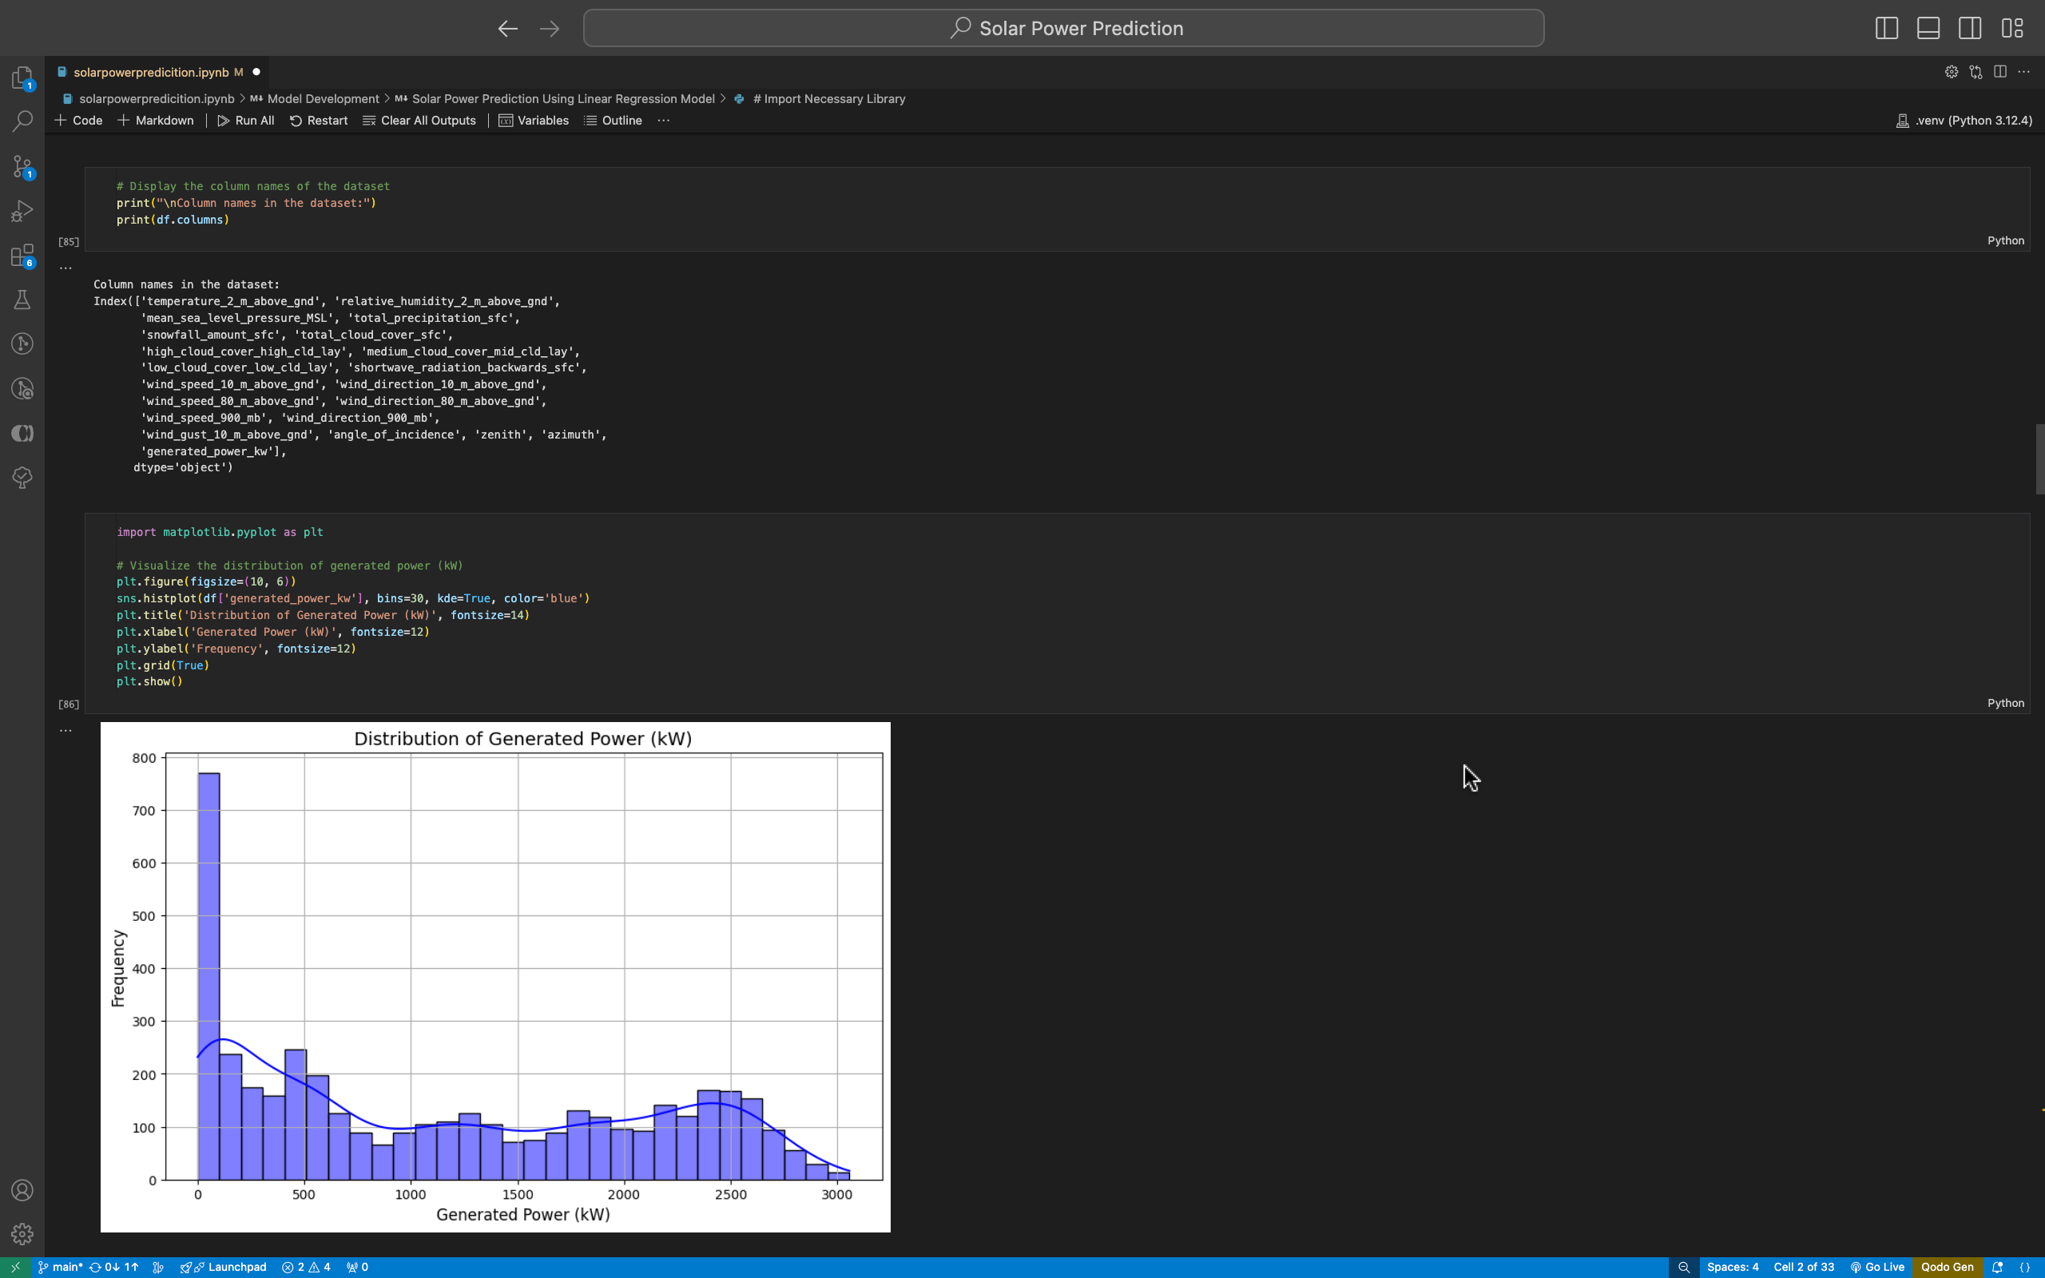
Screenshot of Output:

Slide 9
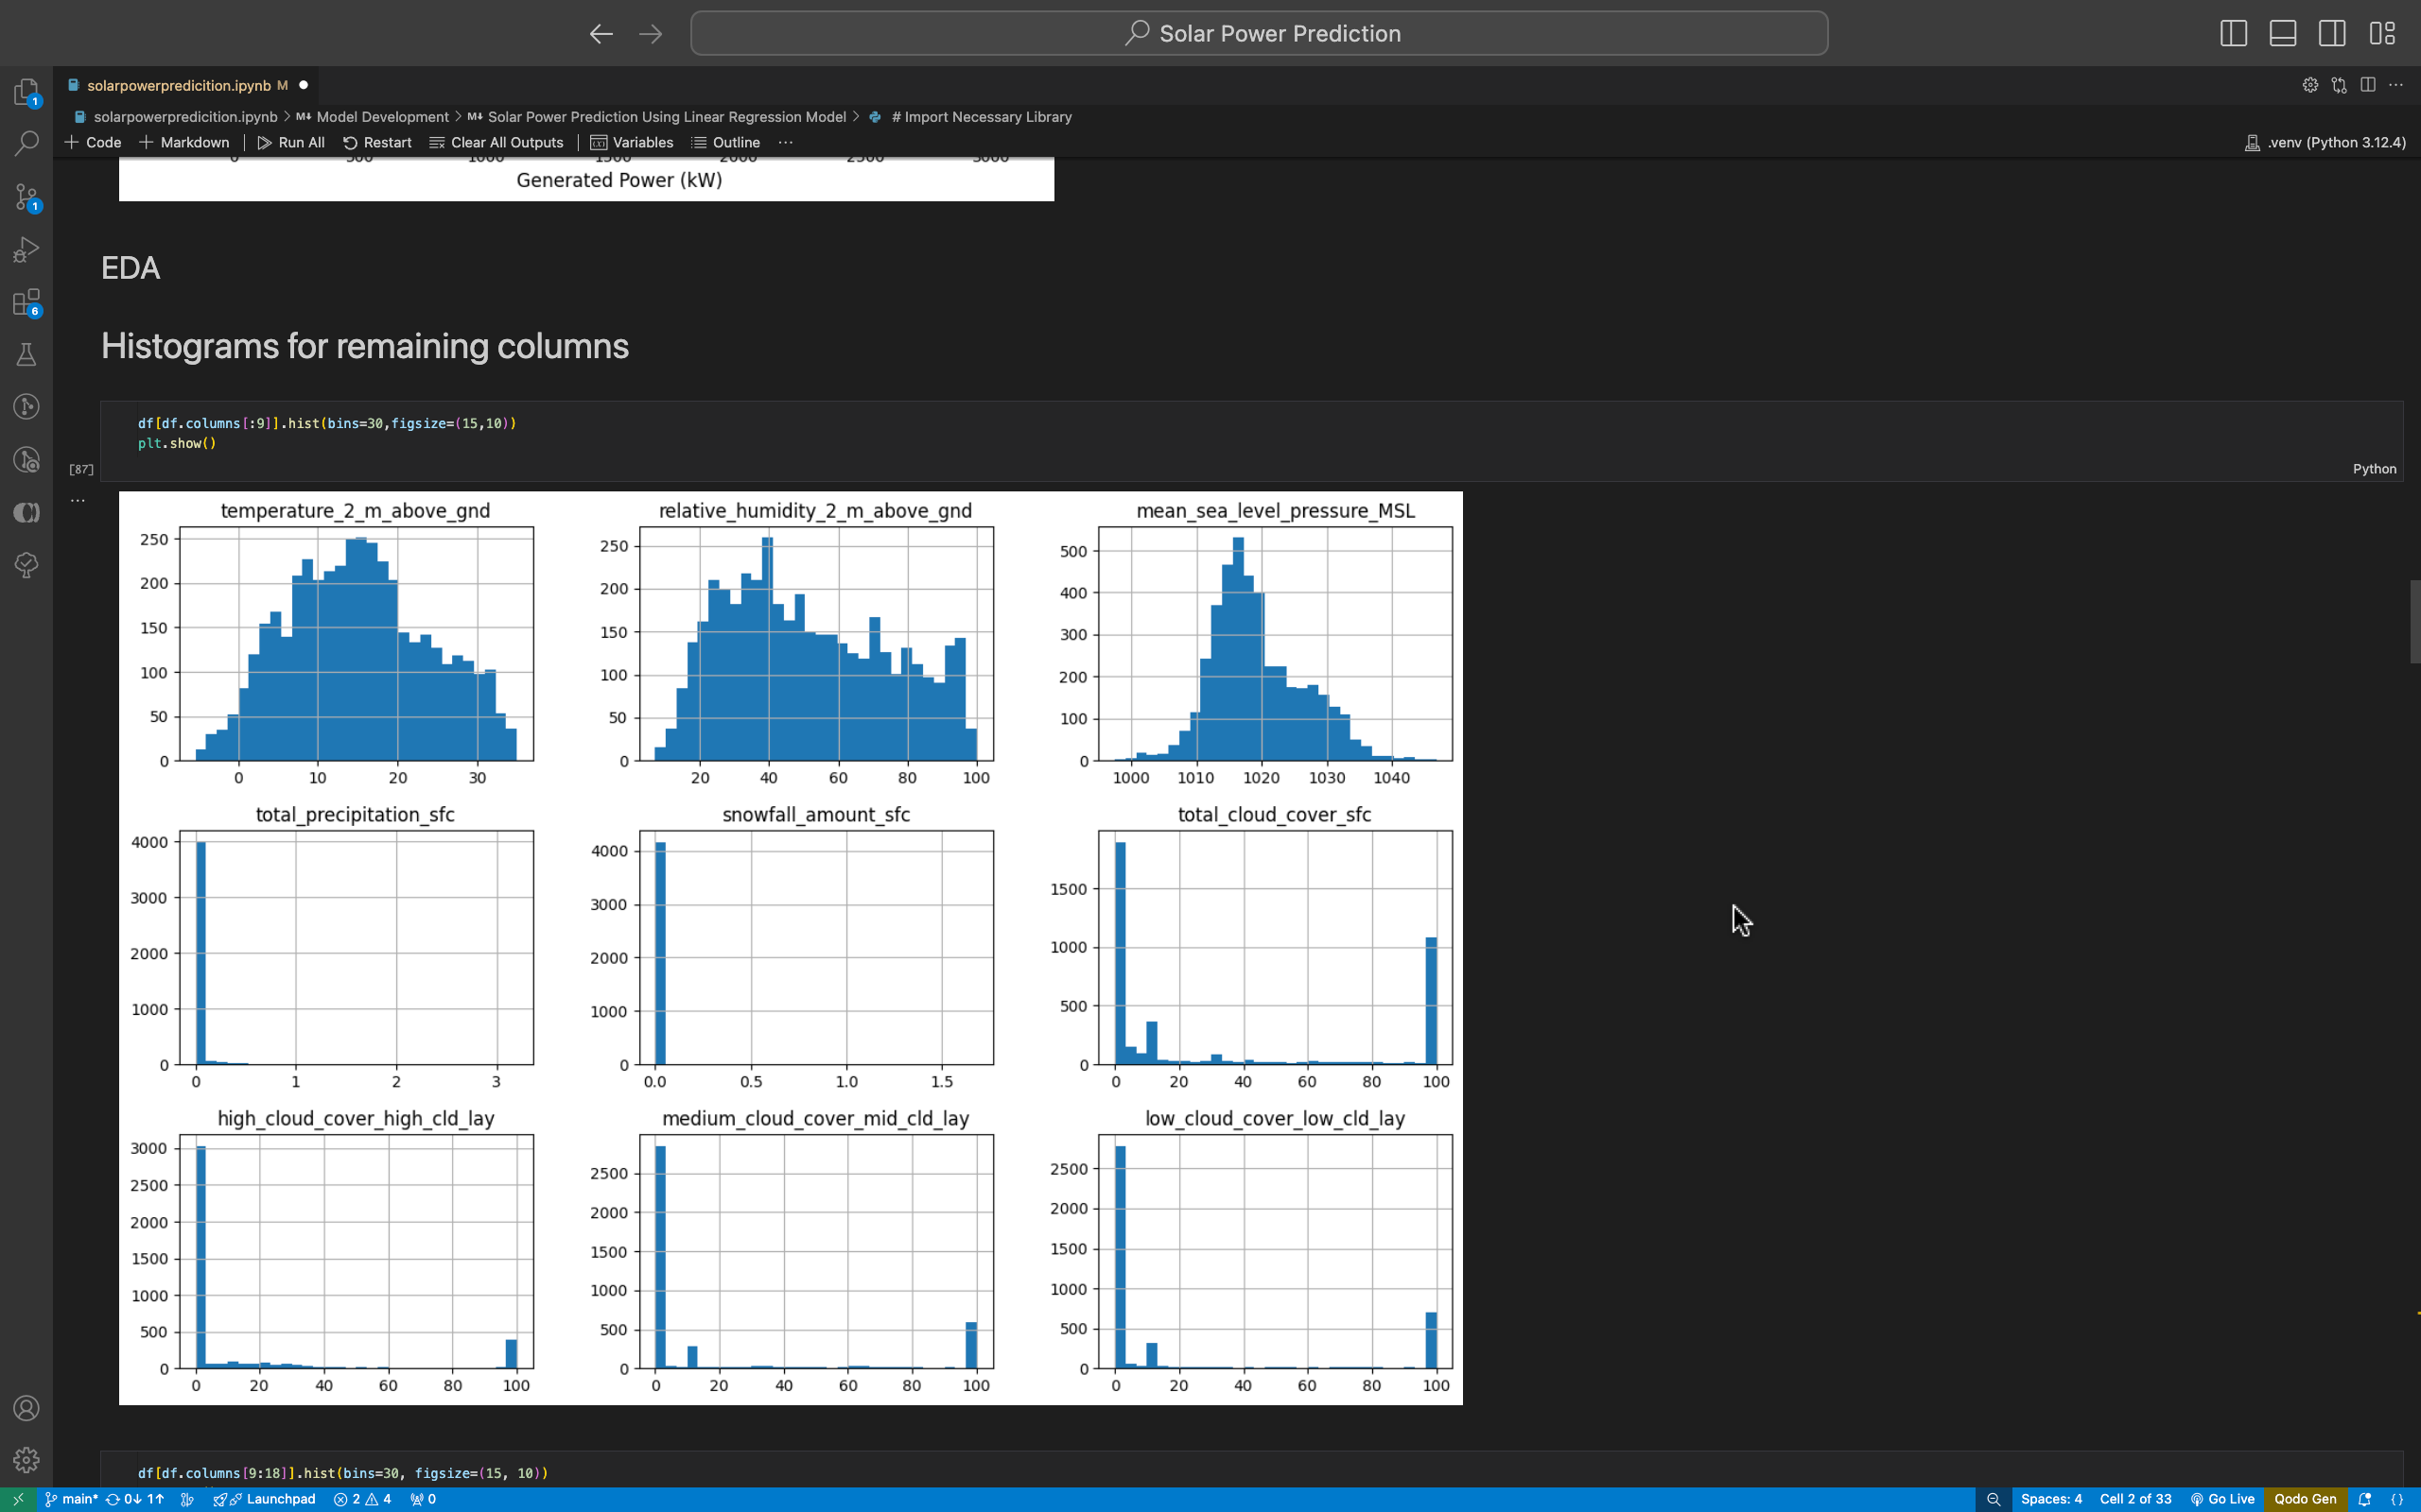
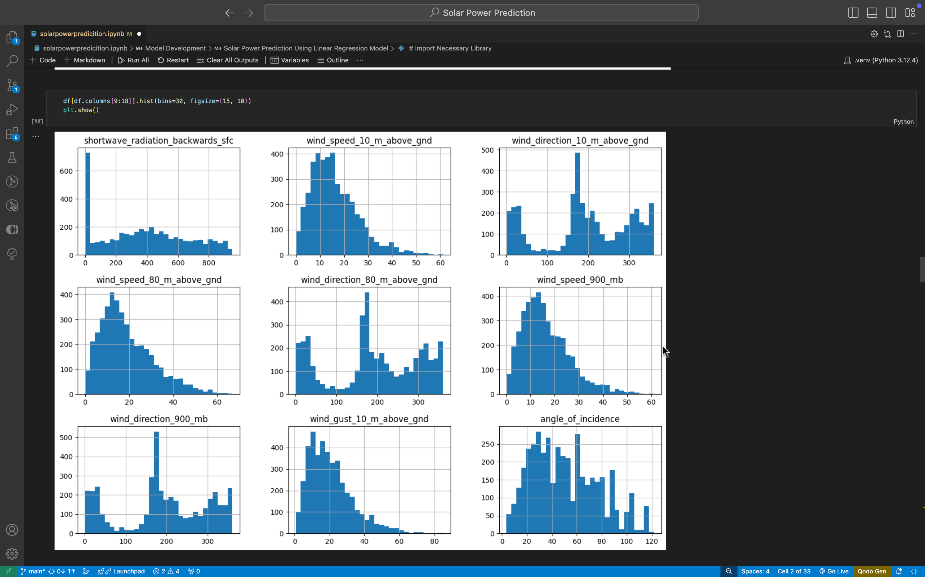
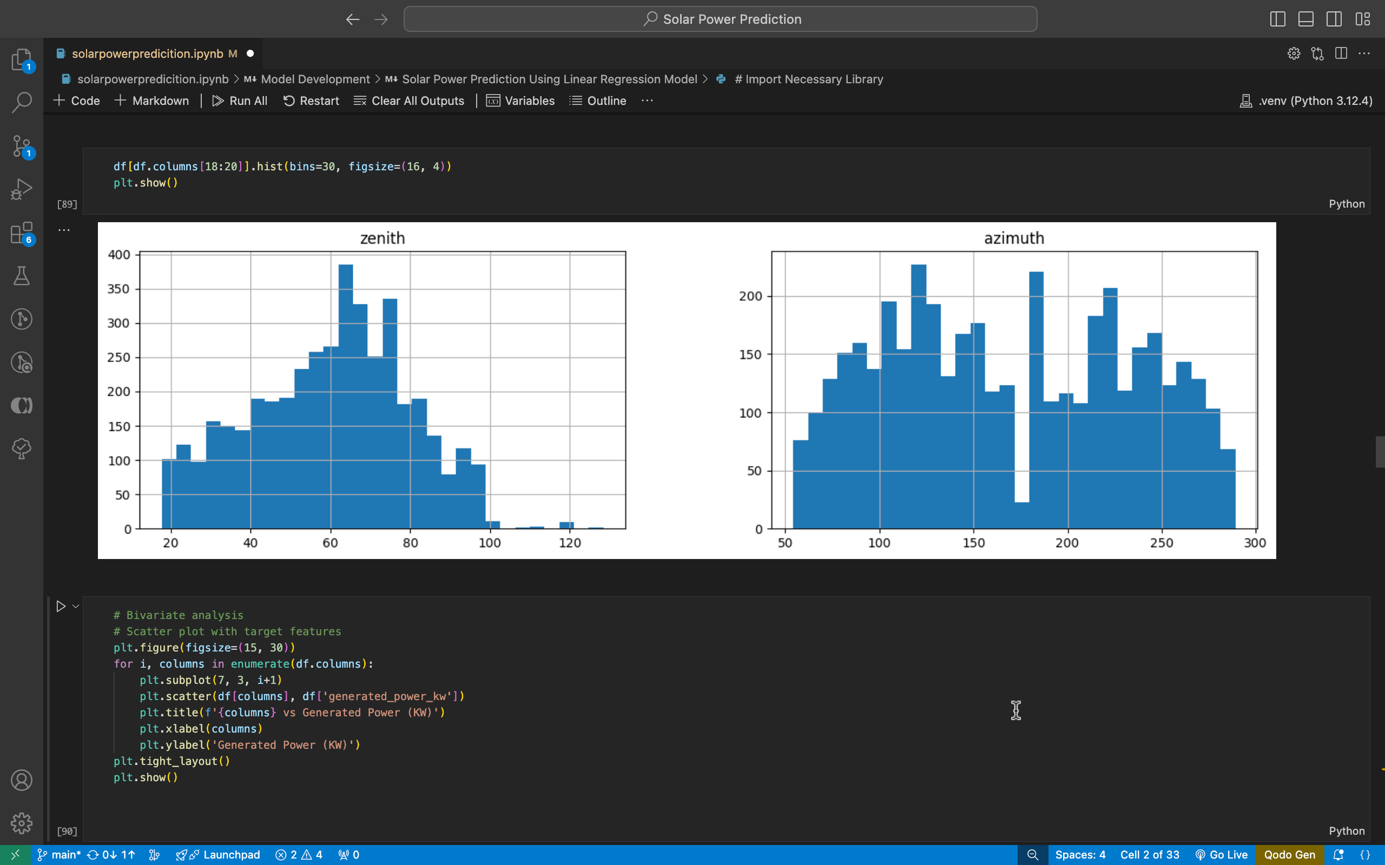
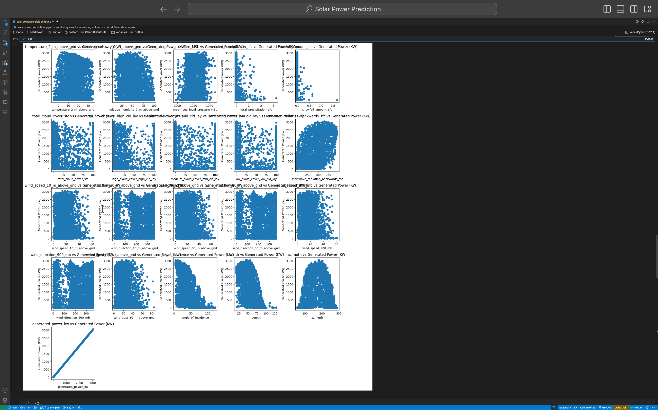
Screenshot of Output:

Slide 10
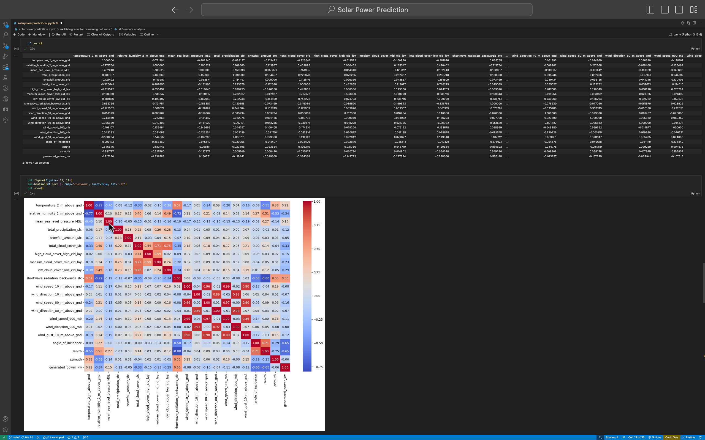
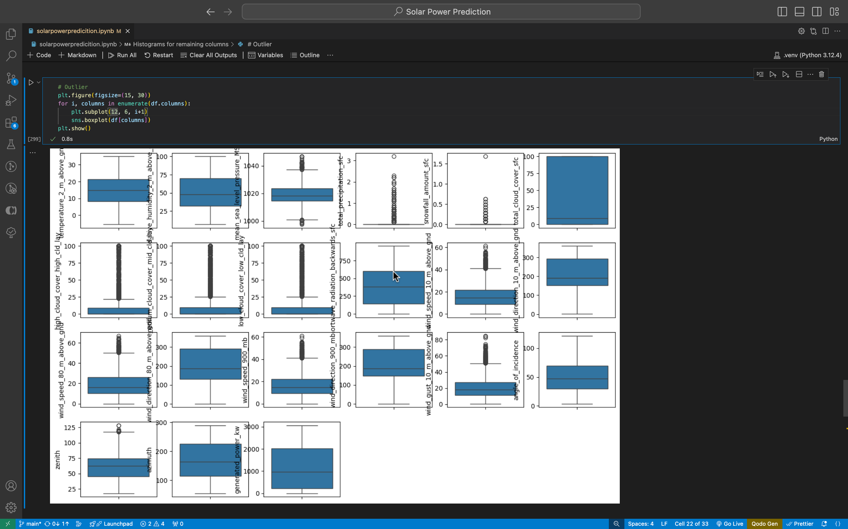
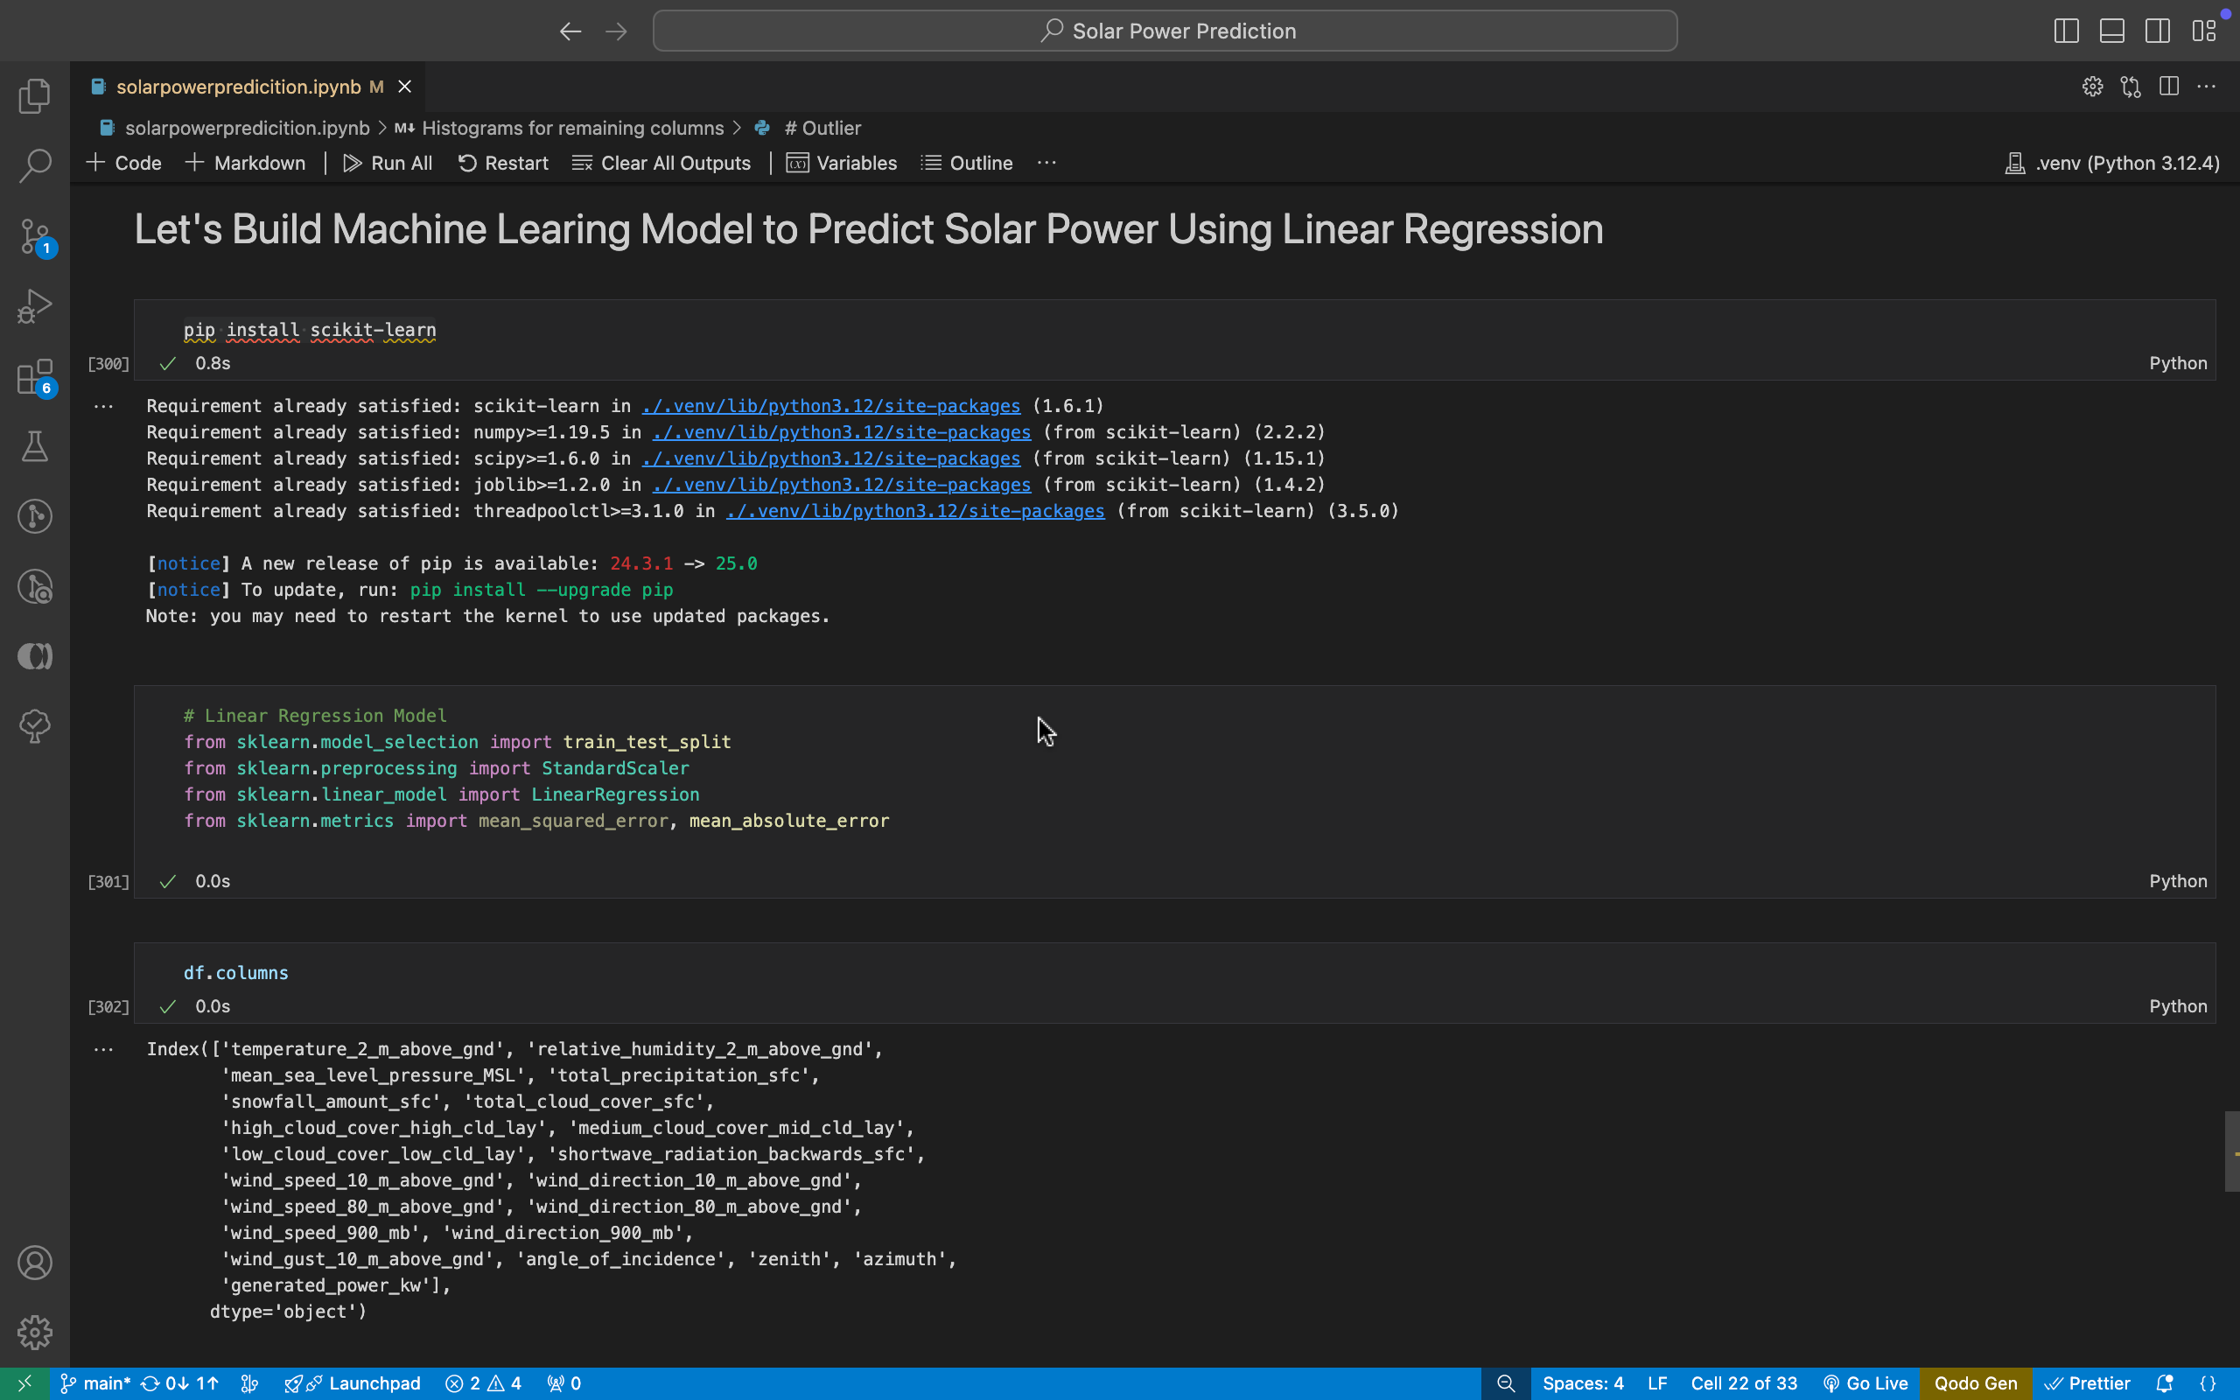
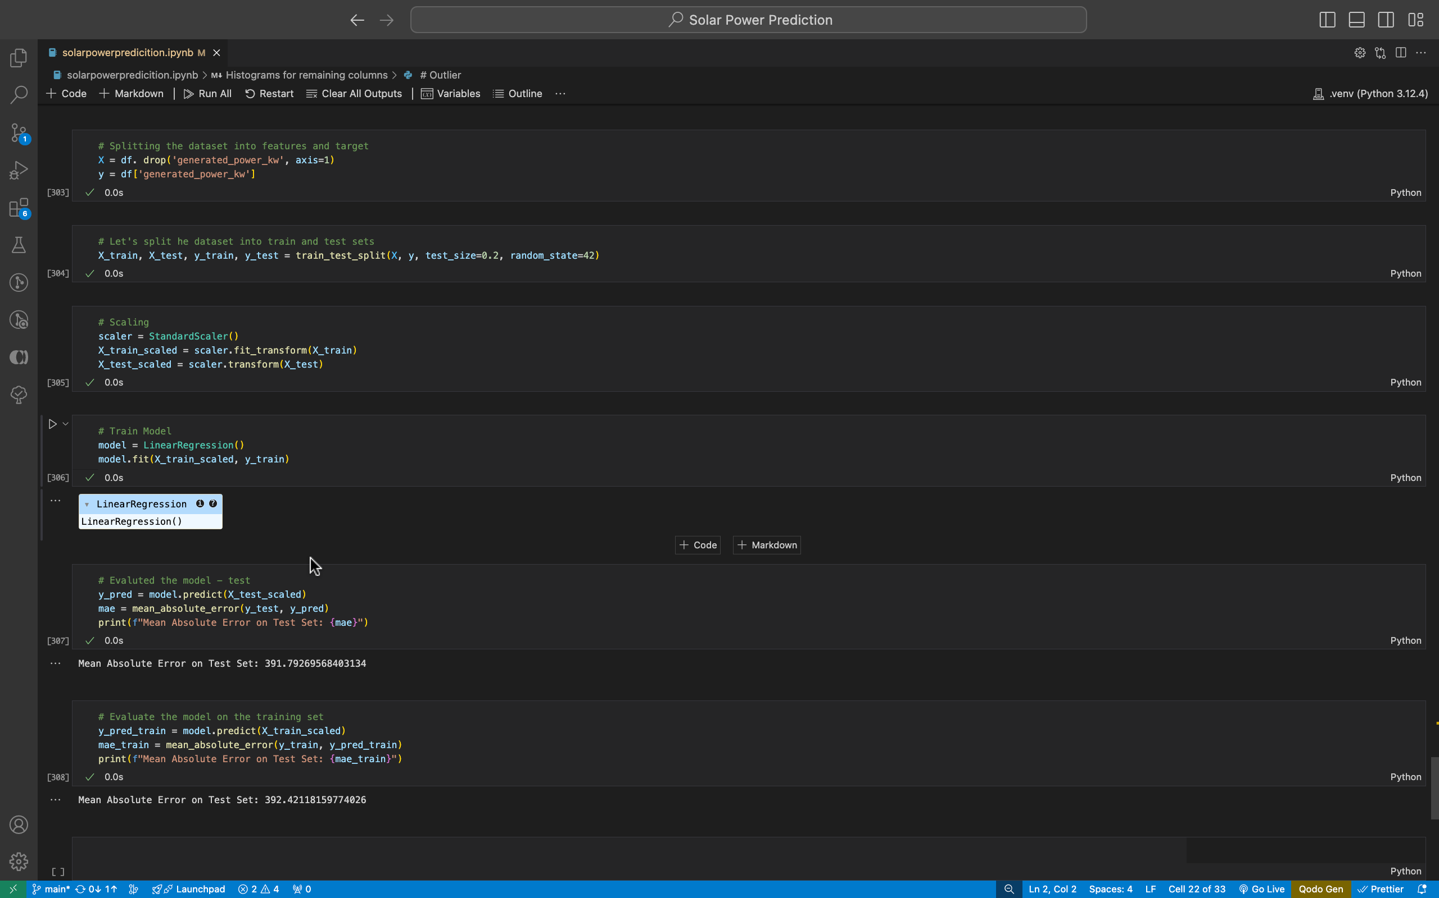
Screenshot of Output:

Slide 11
Conclusion:
This project successfully demonstrated the use of linear regression for predicting solar power output based on environmental factors. The model provided accurate predictions validated by performance metrics such as MSE and R². Key insights from the data and visualizations emphasized the importance of effective preprocessing and model evaluation. This solution can be further scaled and adapted for real-world solar energy management systems, contributing to efficient energy forecasting and grid optimization.

